Slide 1
Matematisk modellering
Guttorm Alendal

Slide 2
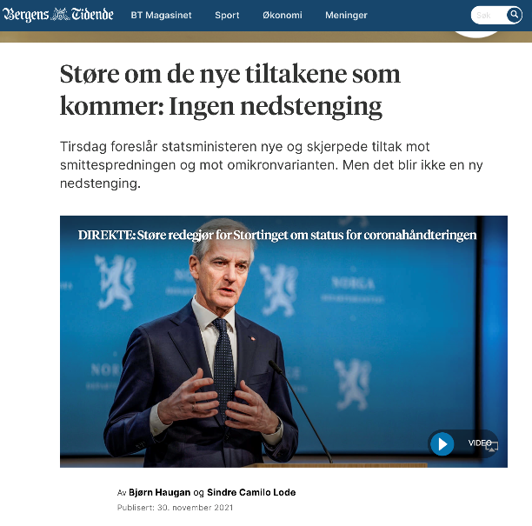
November 30, 2021

Slide 3
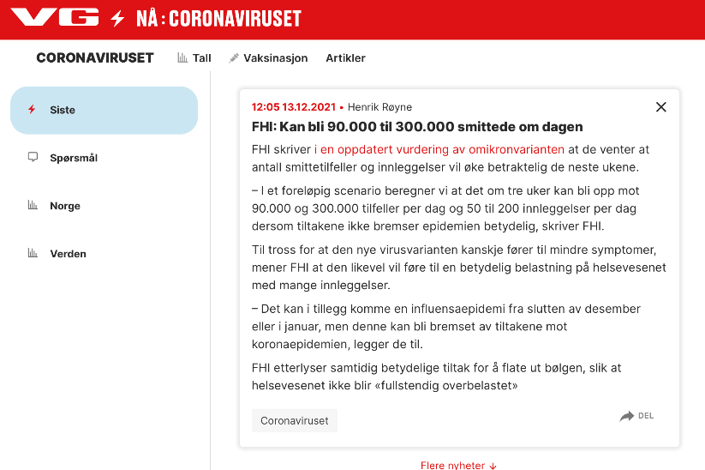
December 13, 2021

Slide 4

January 4, 2022

Slide 5

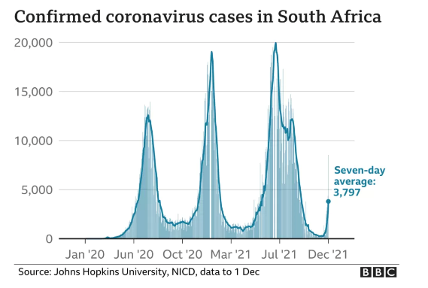
What happened?

Slide 6

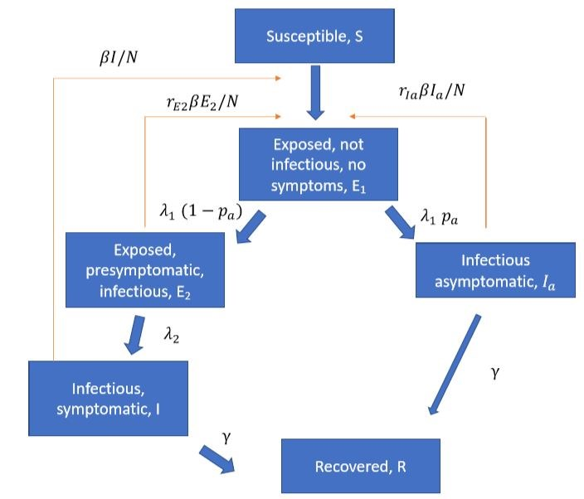
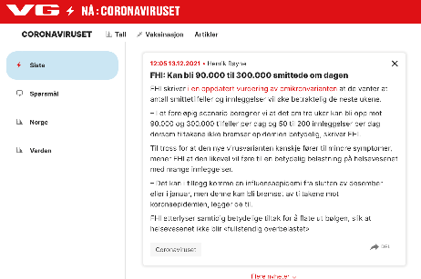
Norwegian Institute of Public Health

Slide 7

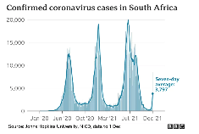

Decisions need to be made!
Under (high) uncertainties

Slide 8

What is mathematical modelling?
The process of representing real-world problems through mathematical equations and concepts.
Problem Definition: Identify the real-world problem.
Formulation: Develop the mathematical model.
Tuning: adjust the model to the real world.
Solution: Solve the equations.
Validation: Compare model predictions with real data.
Implementation: Apply the model to make predictions and decisions.
Generated with AI ∙ 15 September 2024 at 2:50 pm

Slide 9
Why mathematical modelling?
Working together with experiments.
Can’t do experiments: Some phenomena are too large, too small, or too complex to experiment on directly. For example, modelling the behaviour of galaxies or subatomic particles.
Too expensive: Conducting physical experiments can be prohibitively costly. Mathematical models allow for simulations that save on resources and expenses.
Can’t repeat: Certain events, like natural disasters or historical occurrences, cannot be recreated. Models help study these unique events without needing to repeat them.
Impossible or not recommended: Some experiments are dangerous or unethical, such as testing new drugs on humans without prior modelling.
Fill in the gaps: When data is incomplete, models can estimate missing information, providing a more comprehensive understanding.
Predictions: Models can predict future outcomes based on current data, aiding in planning and decision-making.
Forecasts: Similar to predictions, but often used for weather, financial markets, and other time-sensitive fields.
Understanding: Models help us understand complex systems by isolating and analyzing individual components and their interactions.
It’s fun!: For many, creating models is an enjoyable challenge, akin to solving a complex puzzle with real-world applications.

Slide 10
Key Components
Variables: Elements that can change and affect the model.
Equations: Mathematical statements that describe relationships between variables.
Parameters: Constants that define specific characteristics of the model.

Slide 11
Type of mathematical models
Statistical, data driven
Data driven
Statistics, regression
Machine learning
Deterministic, mechanistics
Based on governing laws,
physics
biology.
Other assumptions.
Differential and/or algebraic equations
All models are wrong, some are useful, Georg Box
ABM

Slide 12
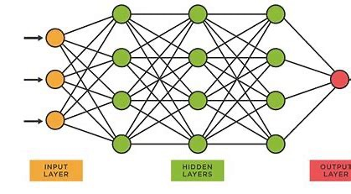

Data driven models
Models that rely on data to identify patterns and make predictions, rather than being based solely on theoretical assumptions.
Data-Dependent: Performance improves with more and better-quality data.
Adaptive: Can adjust to new data and changing conditions.
Predictive: Focus on forecasting future outcomes based on historical data.
Types of Data-Driven Models:
Statistical Models: Use statistical methods to infer relationships between variables (e.g., linear regression).
Machine Learning Models: Use algorithms to learn from data and make predictions or decisions without being explicitly programmed.
Neural Networks

Slide 13
Machine learning
A subset of artificial intelligence (AI) that enables systems to learn from data, identify patterns, and make decisions with minimal human intervention.
Key Components:
Algorithms: Procedures or formulas for solving problems (e.g., decision trees, neural networks).
Training Data: Historical data used to train the model.
Features: Input variables used by the model to make predictions.
Labels: Output variables that the model aims to predict.
Types of ML Models:
Supervised Learning: Models are trained on labeled data (e.g., classification, regression).
Unsupervised Learning: Models find patterns in unlabeled data (e.g., clustering, association).
Reinforcement Learning: Models learn by interacting with an environment and receiving feedback (e.g., game playing, robotics).
Benefits:
Accuracy: Can achieve high levels of accuracy with sufficient data.
Scalability: Can handle large volumes of data.
Automation: Reduces the need for manual intervention.
Challenges:
Data Quality: Requires high-quality, relevant data.
Complexity: Can be complex to develop and interpret.
Ethics: Concerns about bias, privacy, and transparency.

Slide 14
Mechanistic models
Models based on theory, that predict outcomes with certainty, given initial conditions and parameters. Often differential equations.
Key Characteristics:
Predictability: Outcomes are precisely determined by initial conditions.
No Randomness: No element of chance or uncertainty in the model.
Reproducibility: Same inputs always produce the same outputs.
Theoretical Basis:
Examples of Deterministic Models:
Newton’s Laws of Motion:
Hooke’s Law:
Fluid equations:
Benefits:
Accuracy: Provides precise predictions.
Simplicity: Often based on well-established theories.
Reliability: Consistent and reproducible results.
Parameters: with SI units.
Limitations:
Assumptions: Often rely on idealized conditions (e.g., no friction).
Complexity: Can become complex for systems with many interacting components.
Scope: May not account for all real-world factors (e.g., environmental influences).

Slide 15
Combining Machine Learning with Deterministic Models
Physics-Informed Neural Networks (PiNNs): A type of neural network that incorporates physical laws and theoretical models into the learning process.
Key Characteristics:
Hybrid Approach: Combines data-driven methods with deterministic, theory-based models.
Incorporation of Physical Laws: Embeds known physical laws (e.g., conservation laws, differential equations) into the neural network architecture.
Improved Accuracy: Enhances model predictions by leveraging both data and theoretical knowledge.
Components:
Neural Network: The machine learning component that learns from data.
Physical Constraints: Theoretical models and equations that guide the learning process.
Loss Function: Includes terms for both data fitting and adherence to physical laws.
Benefits:
Enhanced Generalization: Better performance on unseen data by incorporating physical laws.
Reduced Data Requirements: Requires less data compared to purely data-driven models.
Interpretability: Provides insights into the underlying physical processes.
Challenges:
Complexity: Integrating physical laws into neural networks can be complex.
Computational Cost: May require significant computational resources.
Model Validation: Ensuring the model accurately represents both the data and the physical laws.

Slide 16

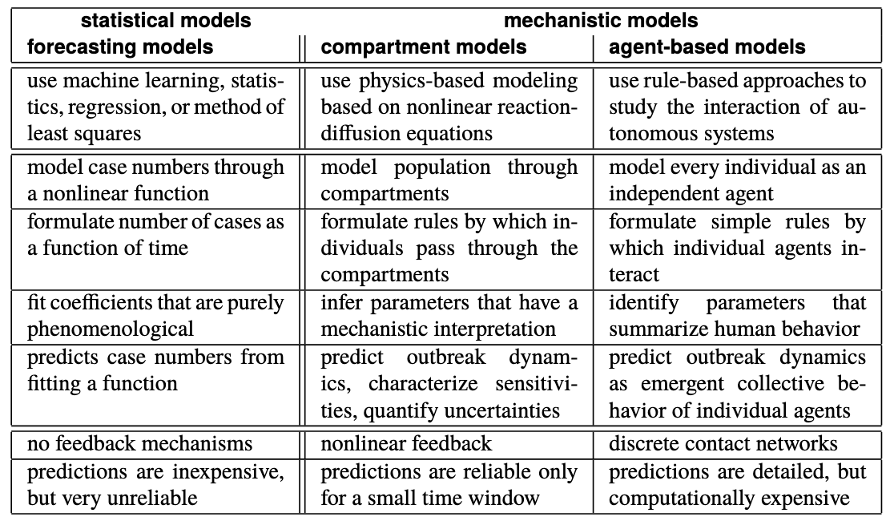

Models in epidemiology

Slide 17
Agent (or Individual) Based Models
Computational models that simulate the actions and interactions of autonomous agents to assess their effects on the system as a whole. Bottom-up modelling.
Key Characteristics:
Autonomous Agents: Each agent operates based on a set of rules and can make decisions independently.
Interactions: Agents interact with each other and their environment, leading to emergent behaviours.
Heterogeneity: Agents can have different attributes and behaviours, reflecting diversity in the population.
Components:
Agents: The individual entities with specific behaviours and characteristics.
Environment: The space or context in which agents operate and interact.
Rules: The set of instructions that govern agent behaviours and interactions.
Benefits:
Flexibility: Can model complex systems with diverse and adaptive agents.
Realism: Captures individual variability and local interactions.
Emergent Behaviour: Can reveal unexpected patterns and dynamics arising from simple rules.
Challenges:
Computational Intensity: Can be resource-intensive, especially with large numbers of agents.
Data Requirements: Requires detailed data to accurately represent agents and their interactions.
Validation: Difficult to validate due to the complexity and emergent nature of the models.
Example Schelling

Slide 18
Compartments models
Mathematical models used to simplify the mathematical modelling of infectious diseases by dividing the population into compartments based on disease status.
Key Characteristics:
Compartments: Groups of individuals categorized by their disease status (e.g., susceptible, infected, recovered).
Transitions: Movement of individuals between compartments based on rates of infection, recovery, and other factors.
Deterministic: Often use differential equations to describe the rate of change between compartments.
Common Types of Compartment Models:
SIR Model: Divides the population into Susceptible (S), Infected (I), and Recovered ® compartments.
SEIR Model: Adds an Exposed (E) compartment for individuals who are infected but not yet infectious.
SIS Model: Individuals move from Susceptible (S) to Infected (I) and back to Susceptible (S) after recovery without immunity.
Components:
Susceptible (S): Individuals who can contract the disease.
Infected (I): Individuals who have contracted the disease and can transmit it.
Recovered (R): Individuals who have recovered from the disease and are immune.
Exposed (E): Individuals who are infected but not yet infectious (in SEIR models).
Benefits:
Simplicity: Provides a clear and structured way to model disease dynamics.
Predictive Power: Can forecast the course of an epidemic and the impact of interventions.
Flexibility: Can be adapted to different diseases and scenarios.
Challenges:
Assumptions: Often rely on simplifying assumptions (e.g., homogeneous mixing of the population).
Data Requirements: Requires accurate data on disease transmission rates and population characteristics.
Complexity: Can become complex when incorporating multiple compartments and factors.
Examples:
COVID-19: Modeling the spread and impact of the virus, evaluating the effectiveness of social distancing and vaccination.
Influenza: Predicting seasonal flu outbreaks and the impact of vaccination campaigns.
Measles: Understanding the dynamics of measles transmission and the effects of vaccination programs.

Slide 19
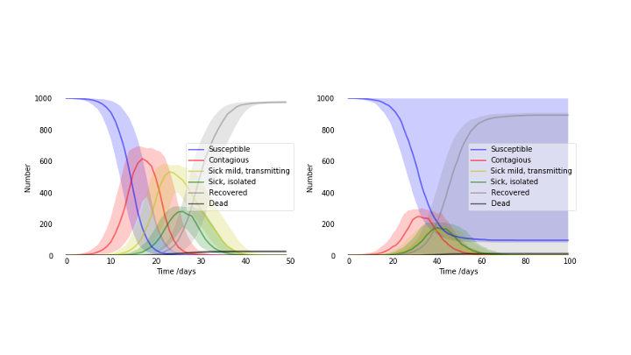

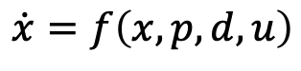
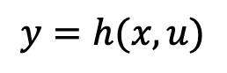
Compartment models
Flatten the curve
Parameters
Rate of change
Input
$$x$$
$$\dot{x}=f\left(x,p,d,u\right)$$
State
variables
Control
$$y=h(x,u)$$
Output or measurement
Main tasks/use:
Tune the model.<-> Data.
How sensitive is the system? <-> Uncertainties, ensembles.
Can we observe the system? <-> Monitoring, detection.
Is the system controllable? <-> measures,
Scenarios. <-> Decisions under uncertainties, Communication.

Slide 20
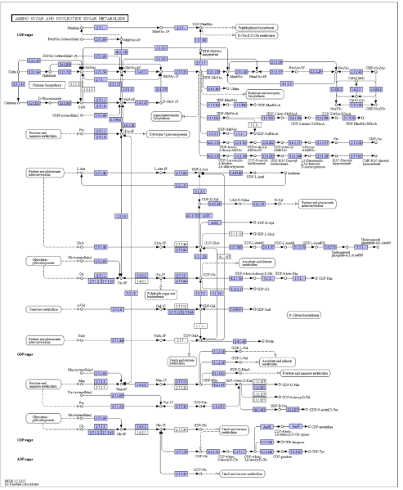
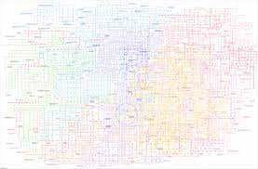
A biological model, metabolism

Slide 21
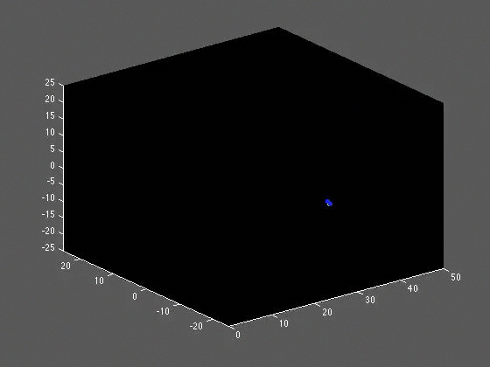
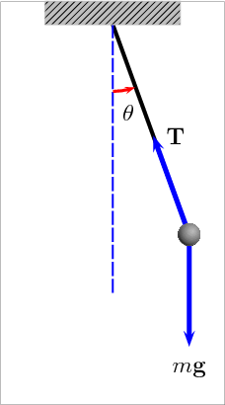
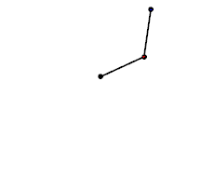

Deterministic vs stochastic
By 100Miezekatzen - Own work, CC BY-SA 3.0, https://commons.wikimedia.org/w/index.php?curid=25184171
By Ruryk - Own work, CC BY-SA 3.0, https://commons.wikimedia.org/w/index.php?curid=14960932

Slide 22
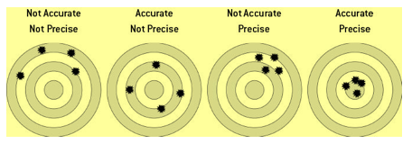
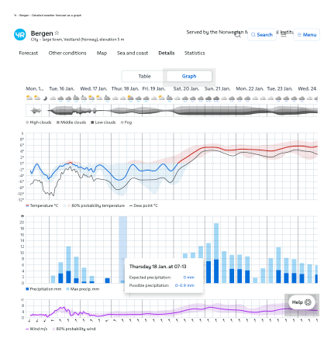
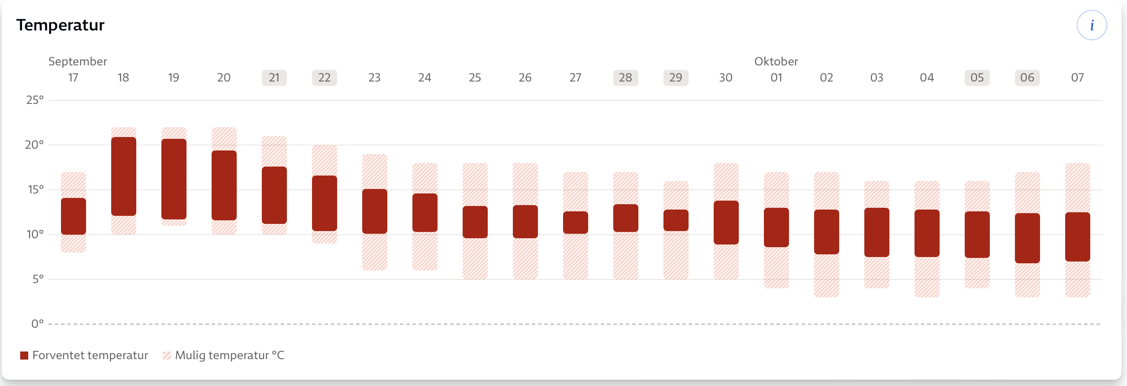
Deterministic models
Nate Silver: The signal and the noise
Even deterministic models has a horizon whereafter the predictions are not reliable.
Uncertainties in
The model itself.
Tuning from observations
Inherent stochasticity
Must run ensembles of simulations.

Slide 23
Aleatory and Epistemic Uncertainties in Modelling
Aleatory Uncertainty:
stochastic or inherent uncertainty, it arises from inherent variability or randomness in the system or environment.
Characteristics:
Cannot be reduced by gathering more information
Examples: Weather variations, material properties, and random failures.
Sources of Uncertainty:
Natural variability in physical systems.
Randomness in human behaviour.
Managing Uncertainty:
Use probabilistic models to account for variability.
Perform sensitivity analysis to understand the impact of variability.
Epistemic Uncertainty:
systematic or reducible uncertainty, it arises from a lack of knowledge or information about the system.
Characteristics:
Can be reduced by gathering more information or improving the model.
Examples: Incomplete data, model assumptions, and measurement errors.
Sources of Uncertainty:
Limited data availability.
Simplifications and assumptions in models.
Measurement inaccuracies.
Managing Uncertainty:
Gather more data and improve data quality.
Refine models and reduce assumptions.
Use expert judgment and validation techniques.
Benefits of Understanding Uncertainty:
Improved Decision-Making: Helps in making informed decisions under uncertainty.
Risk Management: Identifies and mitigates potential risks.
Model Improvement: Guides efforts to refine and validate models.
Colab

Slide 24
The FHI model
What can we add?

Slide 25
https://colab.research.google.com/github/galendal/model_prepare/

Slide 26
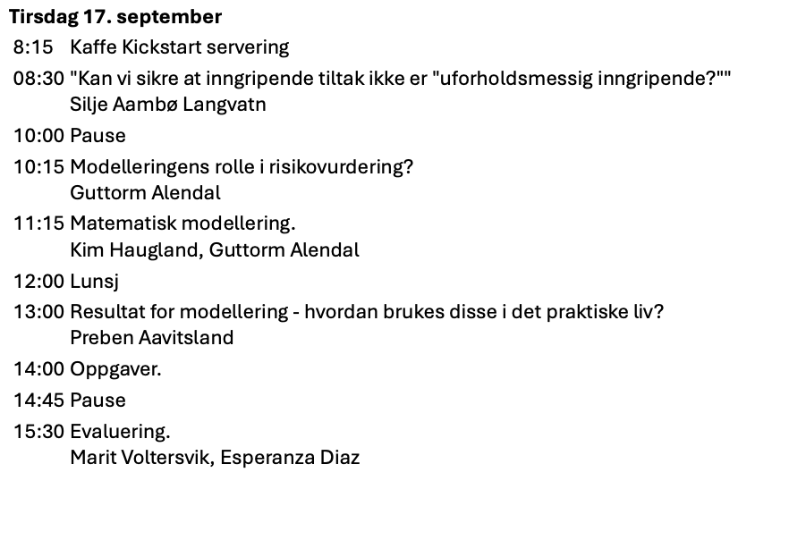

Slide 27
Last page
uib.no

